Slide 1
UAV swarms under : Defence and Counter Measures
Group Members:
Sahil Kaushik - 231010240
Mukund Thakur - 231010230
Satyendra Kumar Tandan - 231010242
Supervised By:
Shrivishal Tripathi

Slide 2
Introduction
Overview:
The need for advanced defence mechanisms in modern warfare
Drone swarms offer rapid response capabilities through detection, evasion, and interception strategies.
Software used:
gazebo + ROS + ardupilot (faced many errors, because of version issue)
Unreal engine + Mircrosoft AirSim (faced plugin issue & extensive use of GPU)
WeBots + ROS (faced problems in integrating multiple drones, and env issues)
CoppeliaSim + ROS (Successful implementation)
Key Use Cases:
Missile Detection & Evasion
Sacrificial Interception
Missile Redirection (Kamikaze Mode)

Slide 3
Working Principles & Core Features
Sensor & AI Integration
Rapid threat assessment determines whether to evade, intercept, or redirect missiles.
Dynamic Decision-Making
Automatically deploys the optimal countermeasure: dodge, sacrificial intercept, or redirection.
Swarm Coordination & Formation Control
Drones can shift among various formations (line, triangle, circle) to optimize defence or confuse adversaries.
Dynamic pattern visuals enhance situational awareness and tactical signaling.
Dual-Mode Operation
Standard Mode: Routine navigation and patrol.
Emergency Mode: Includes kamikaze and redirection strategies for critical threats.

Slide 4
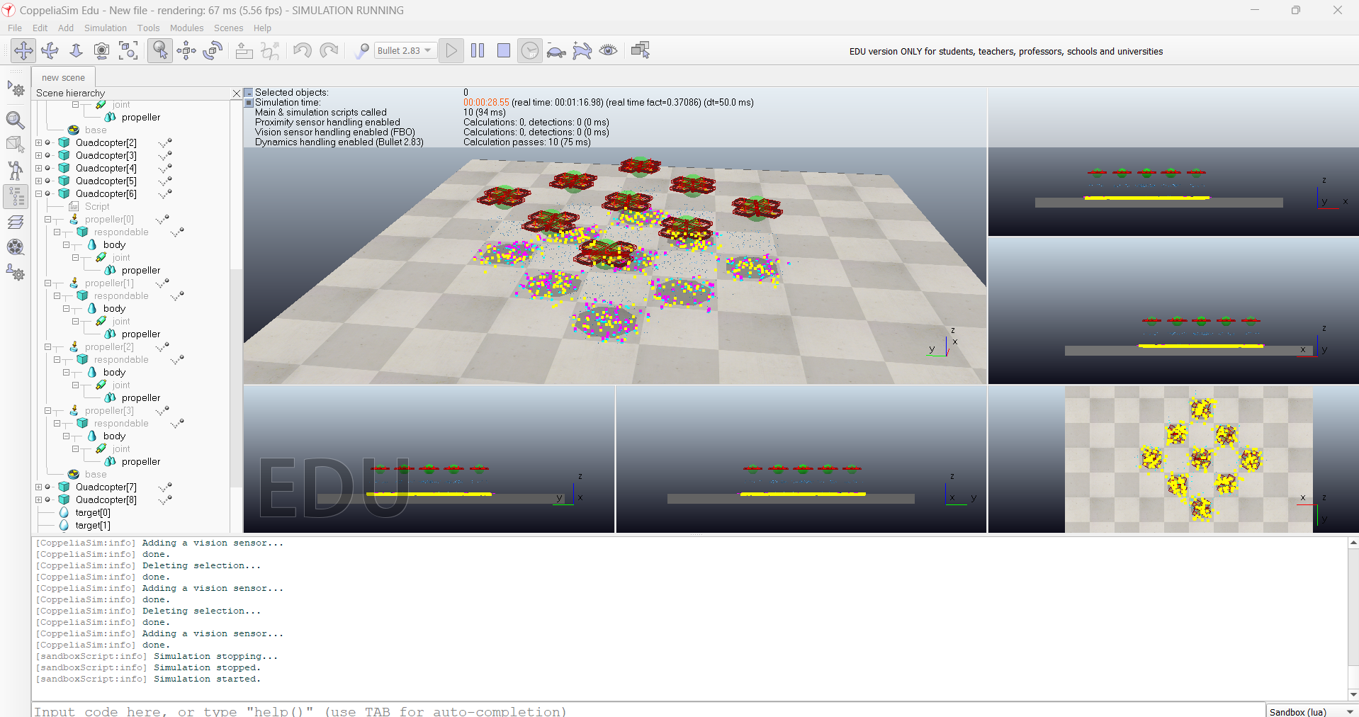
Link for demonstration - LINK
Results

